Slide 1
Digital portfolio
STUDENT NAME: MOHAMMED SHOWKATH B
REGISTR NUMBER AND NMID:astvu20920924u09116
DEPARTMENT:BCA
COLLEGE AND UNIVERSITY:SHANMUGA INDUSTRIES ARTS AND SCIENCE COLLEGE/THIRUVALLUVAR UNIVERSITY

Slide 2
PROJECT TITLE :
DIGITAL PORTFOLIO:FOOD HOTEL

Slide 3
AGENDA:
1.problem statment .
2. Project Overview.
3. End Users.
4. Tools and Technologies.
5. Portfolio Design and Layout.
6. Features and Functionality.
7. Results and Screenshots.
8. Conclusion.
9. GitHub Link.

Slide 4
Problem Statement:
1.Customers face difficulty in accessing food menus online.
2.Lack of a centralized platform for ordering and contacting the hotel.
3.Traditional methods of booking and ordering are time-consuming.

Slide 5
Project Overview:
1.A responsive website for a Food Hotel with attractive design.
2.Provides details about menu, order system, and contact information.
3.Enhances customer engagement with easy-to-use interface.

Slide 6
End Users:
1.Customers: To view menus and place food orders online.
2.Hotel Management: To manage menu items and customer requests.
3.Visitors: To explore the hotel services and contact details.

Slide 7
Tools and Technologies:
1.Frontend: HTML, CSS, JavaScript.
2.Design: Dark blue theme with images for better UI.
3.Hosting/Deployment: GitHub for version control and portfolio sharing.

Slide 8
Portfolio Design and Layout:
1.Logo on the left, Food Hotel name on the right for branding.
2.Menu, order section, and contact details clearly organized.
3.Attractive color scheme with responsive design for all devices.

Slide 9
Features and Functionality:
1.Online food menu with images and prices.
2.Contact form for booking and queries.
3.Order system integrated for better customer experience.

Slide 10
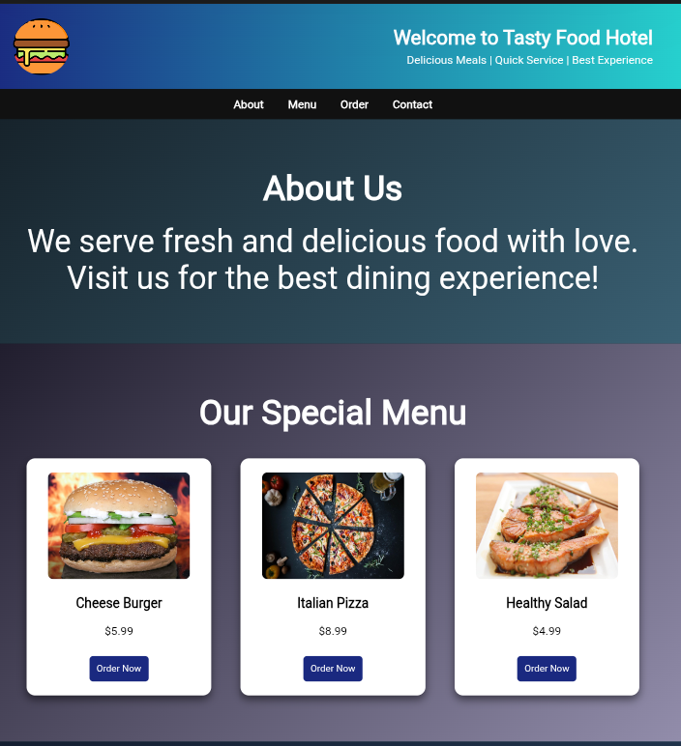
Results and Screenshots:

Slide 11
Conclusion:
1.The project provides an efficient solution for hotel–customer interaction.
2.It reduces time and enhances user satisfaction.
3.Can be extended with payment gateway and real-time booking features.

